Slide 1
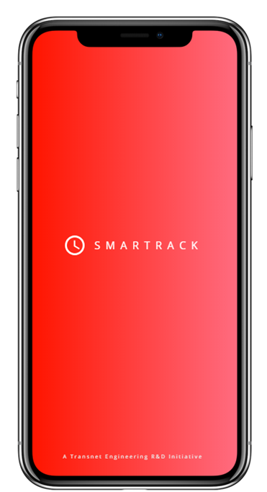
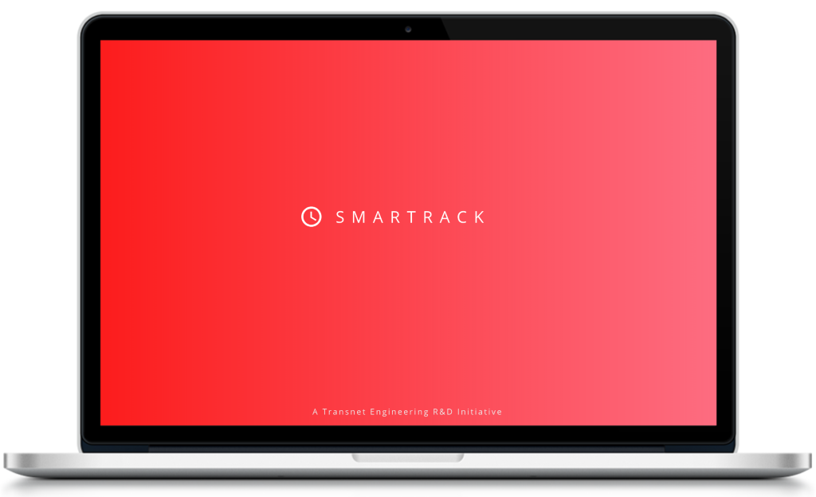


I & I Peer Presentation
Time Tracking System for Transnet Engineering R&D
Jed, Imraan, Susan, Wing, Thapelo S
August 2018
T I M E T R A C K E R F O R T R A N S N E T E N G I N E E R I N G R & D

Slide 2
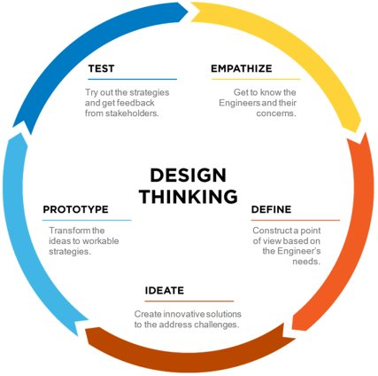
THE NEED
Business Need
The South African Revenue Services (SARS) incentivises companies to spend money in R&D by allowing them tax incentives/rebates per approved research project.
TE’s aim to be an Original Equipment Manufacturer (OEM) into Africa and the Middle East so the number of billable worked hours must be captured per resource per project to price products/services correctly.
Project Need
Even though old systems were implemented, the usage is low and the mandatory requirements stated above are still not addressed.
The need is to create a system that will increase user usage. This project aims to understand why the current system is not being used and what can be changed to make the user experience better.
Applied to the Time Tracking System
T I M E T R A C K E R F O R T R A N S N E T E N G I N E E R I N G R & D

Slide 3
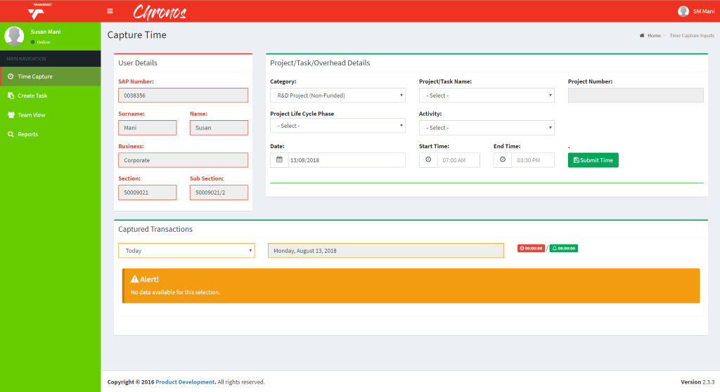
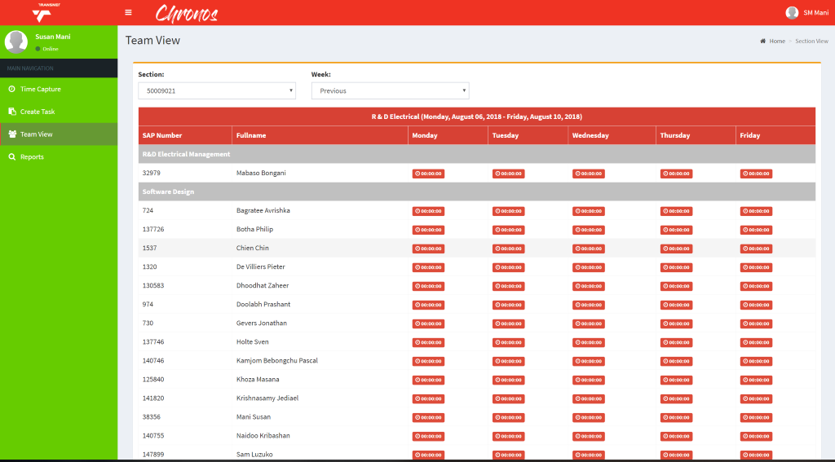
EMPATHIZE
Surveys sent to all users: Requested pain points of the current system
Conducted specific interviews with Engineers, Principal Engineers and Project Managers:
Responses:
“The workflow should be date>time>task” – N. Mahomed
“Lunch counter that takes the assigned time from the booked time” – K. Boshoff
“Does the time submitted need to be done chronologically?” – S. Shangase
“Make a special function to capture leave – start and end day” – C.Seindis
“Hours per resource and project should be shown per project for Finance” – K Boshoff
“All Finance needs is % of hours per resource per project, engineering hourly rates and a calculation of the two” – N. Mahomed
Hands-on experience sessions (shadowing) conducted by trying the previous solutions enabling a better understanding why the previous system failed. Went through each flow of the system to grasp the issues.
T I M E T R A C K E R F O R T R A N S N E T E N G I N E E R I N G R & D

Slide 4
DEFINE
Multiple Problems Identified After Empathise, these few problem statements were needed to have an holistic system solution:
Develop an easy-to-use and low-administrative time-tracking system for Engineers at TE R&D that will increase overall system usage.
Create a clear trail of billable working hours of Engineers on R&D Projects for audit purposes and customer billing for Management reporting to Finance.
Develop a time tracking that allows Management to view complete Team Productivity and Resource Constrained projects.
Stakeholder identification
Pain points, Challenges, Decisions
Stakeholder | Personas | Role objective
Engineers | Direct Users (Input to System) | Daily project tracking
Principal Engineers (Managers) | Direct Users (Input to System) Team/Project Management: (Output of System) | Project tracking Team Performance View resource allocation
Project Managers | Project Management (Output of System) | Improve project tracking Project end date forecasting
Finance | Auditors (Output of System) | Billable working hours per project Audit trial of engineer time spent % time worked on projects
Main Challenges/Pain Points: | Key Decisions / Design Criteria
Leave Capturing per day | Integrate to HR systems
Too many clicks to capture | 2 click process max
GUI not user friendly | Design Flow for GUI
Time per minute selection is overkill | Log only hours per project
Daily tracking tedious/ weekly tracking – forget what was done | Auto-populate activities – confirm if correct
Too many types of tasks/phases to select from | Reduce number of tasks per project
T I M E T R A C K E R F O R T R A N S N E T E N G I N E E R I N G R & D

Slide 5
IDEATE
Only solves attendance
Concept great! – needs to be elaborated
Existing Tools (RescueTime, Tutos, Jiggl, etc.)
Voice controlled time tracker
Camera – face tracker
Actionable items after Idea Brainstorm:
Customized Web App - > “CONFIRMATION” of activities - > seamless integration - > timesheet concept
Biometric tracking
Too pricey
Overkill solutions / not easily adaptable for our needs
Timesheet (manual)
Seamless addition of HR System
Concept good – needs to be elaborated
Pocket camera that checks what is being done
Web App that pops up and requests confirmation on current work
Concept great! – needs to be elaborated
Privacy invasion
Privacy invasion
Many ideas were generated – most feasible are listed here!
T I M E T R A C K E R F O R T R A N S N E T E N G I N E E R I N G R & D

Slide 6
IDEATE
Feature Brainstorm IDEAS
Less than 2 clicks to track a task
No user input, only confirmation of allocation
List of assigned projects automatically added
Log only hours per project not time sequentially
Must be able to add ad-hoc projects and include till allocated to site work
Link to SAP, other sharing platforms like Calendar, Google Keep, TFS, etc.
Sign on machine means you at work
Possible to add management as a task
Use a machine learning model to see what you generally would be doing at a time and predict options for you to select
Views:
Project view
Personal view
Finance view
Use counters instead of inserting time
Multi-platform: mobile and laptop
Shortlist tasks – 5 max per personal, management and project
T I M E T R A C K E R F O R T R A N S N E T E N G I N E E R I N G R & D

Slide 7
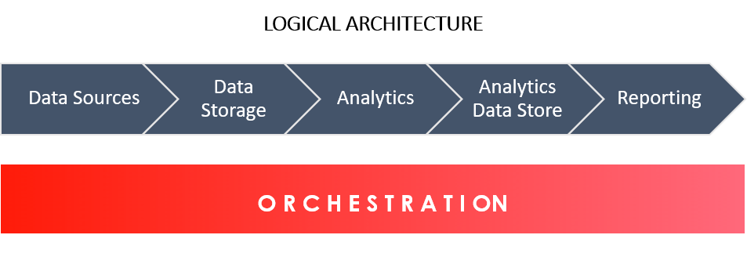
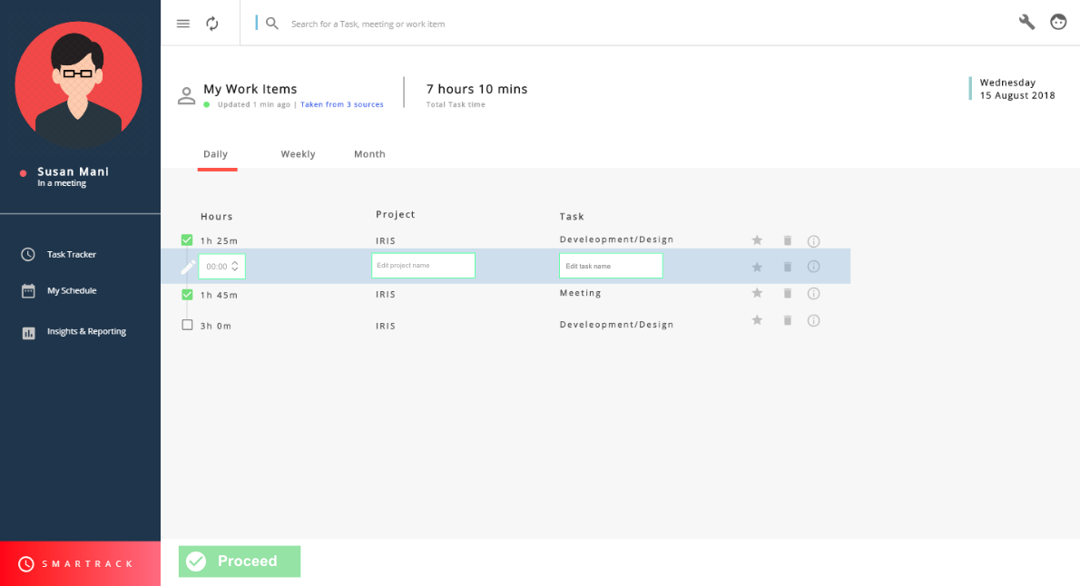
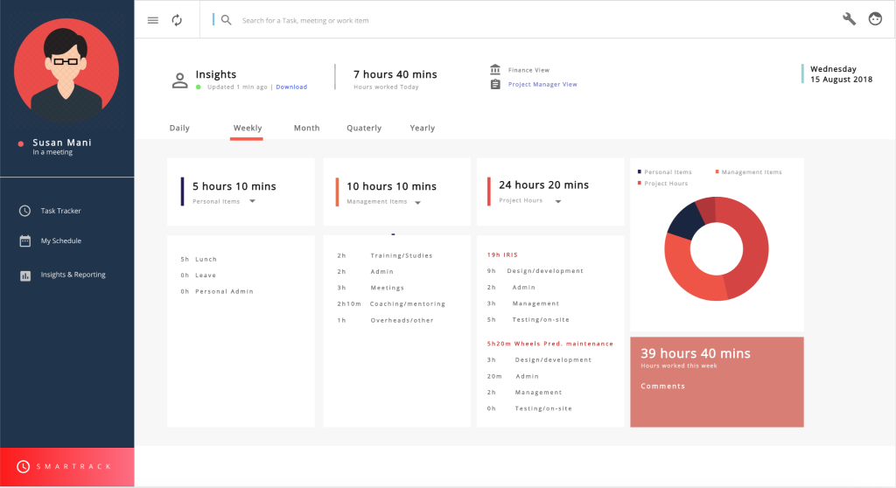
PROTOTYPE
Various versions and representations were thought out and designed.
Shown below is the first viable solution design passed for testing.
Developed a few iterations of the prototype to appropriately evaluate the features against critical success factors.
T I M E T R A C K E R F O R T R A N S N E T E N G I N E E R I N G R & D

Slide 8
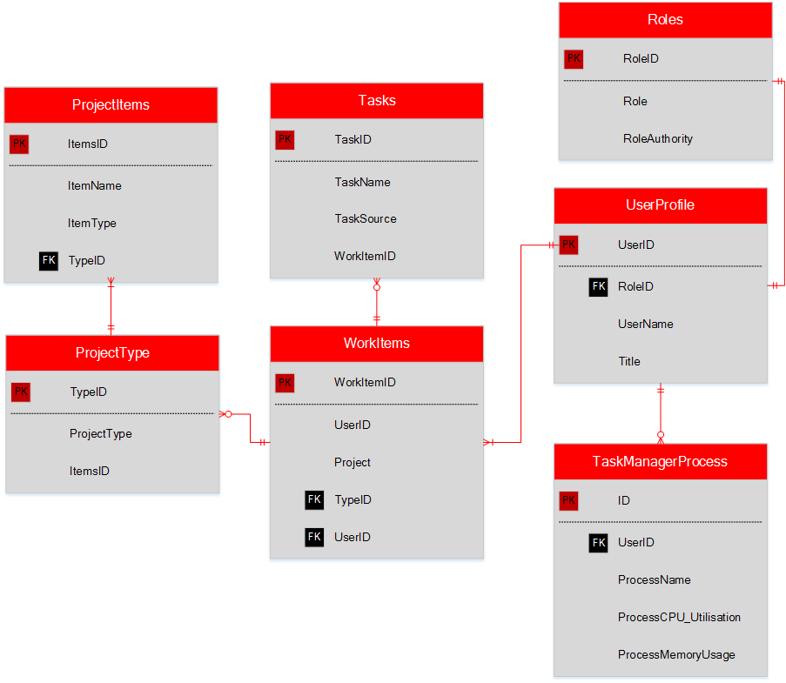
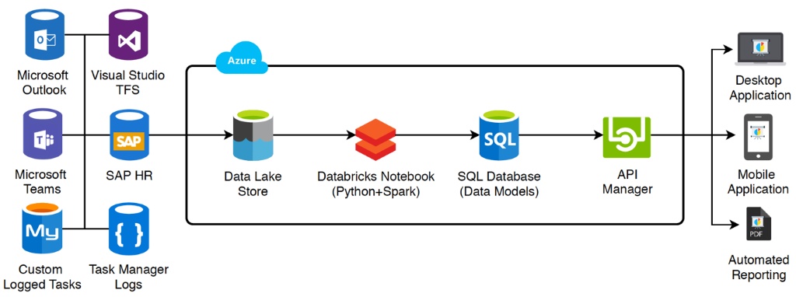
PROTOTYPE
A few concepts were designed for the architecture and data model.
Had to validate the need for each system to be integrated into the final solution
Data Model Architecture
Solution Architecture
T I M E T R A C K E R F O R T R A N S N E T E N G I N E E R I N G R & D

Slide 9
TEST
Two methods:
The team evaluated the design to see if it met all stakeholder requirements. The concept was also measured against its critical success factors:
An effective and simple User Interface
Minimal input from the user
Optimal summarized reporting.
The concept was shared via a link on a platform called UXpin. This allowed multiple users to test the prototype at the same time. It was sent to many Engineers and Principal Engineers. Engineers tested usage ability and Principal Engineers assessed the solution against what they’d want to show Finance.
Some of the following feedback that was received:
“There is no way that a user can add their own task, there should be a button that allows the user to add a task manually. Otherwise I’m keen to play around with it.” : K Naidoo (Engineer)
“It’s definitely a massive improvement from the previous system. One thing to note: clicking to complete a task for every task is a tedious process. This was one of the concerns of the previous systems, it would be great if there was a way to just click once for everything” : J Chien (Engineer)
“Interface is great! I’m very excited. For intellectual property sake, it may not be ideal to display the costing and financing figures to everyone. Perhaps allow for administrators and managers to view it. Maybe have it visible, but locked in a way” : N Mahomed (Principal Engineer)
T I M E T R A C K E R F O R T R A N S N E T E N G I N E E R I N G R & D

Slide 10
TEST & FINAL PROTOTYPE
Prototype
[Design solution to meet initial requirements]
Test
[Send UXPin link for review]
Prototype
[Resolve bugs & issues]
The final solution showed all the resolved issues from the feedback received from both methods of testing.
Feedback
T I M E T R A C K E R F O R T R A N S N E T E N G I N E E R I N G R & D

